Slide 1







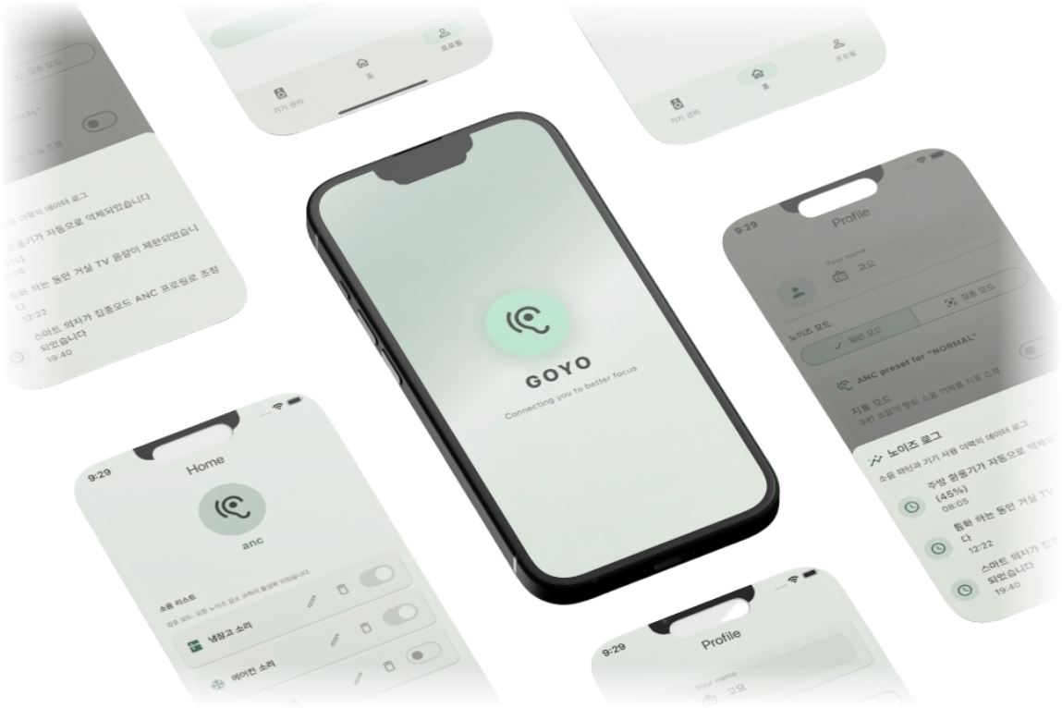



GOYO
Connecting you to
better focus
Taerim Kim, Information System
Wongyu Lee, Information System
Junill Jang, Information System
Hoyoung Chung, Information System

Slide 2







Motivation
Work from Home: New Normal
Widespread adoption of working/studying from home post-COVID
Reduced Concentration from Appliance Noise
Continuous operating sounds (e.g., fans) hinder work immersion
Wearing ANC-enabled devices
ANC(Active Noise Cancellation): Cancels external noise by generating opposing sound waves simultaneously

Slide 3
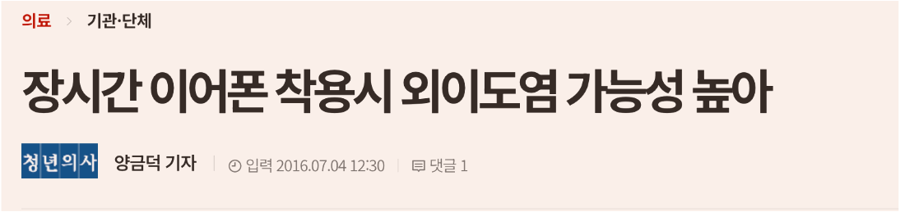
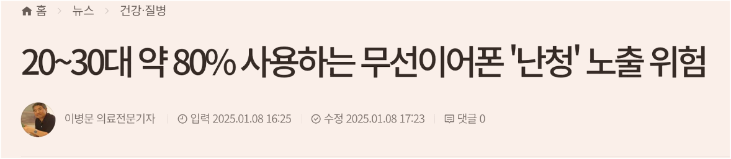
Motivation
Work from Home: New Normal
Widespread adoption of working/studying from home post-COVID
Reduced Concentration from Appliance Noise
Continuous operating sounds (e.g., fans) hinder work immersion.
Wearing ANC-enabled devices
ANC(Active Noise Cancellation): Cancels external noise by generating opposing sound waves simultaneously

Slide 4








Our Project
Our project “GOYO”
Current ANC
Non-wearable Spatial Control
Creates a 'Quiet Zone' using only speakers
without wearing any devices.
Selective Cancellation
Eliminates only target noise (e.g., appliances) while preserving essential sounds.
Device Dependency
Requires wearing earphones/headset Ear pressure and physical pain
Indiscriminate Blocking
Blocks all sound
including alarms, conversation

Slide 5




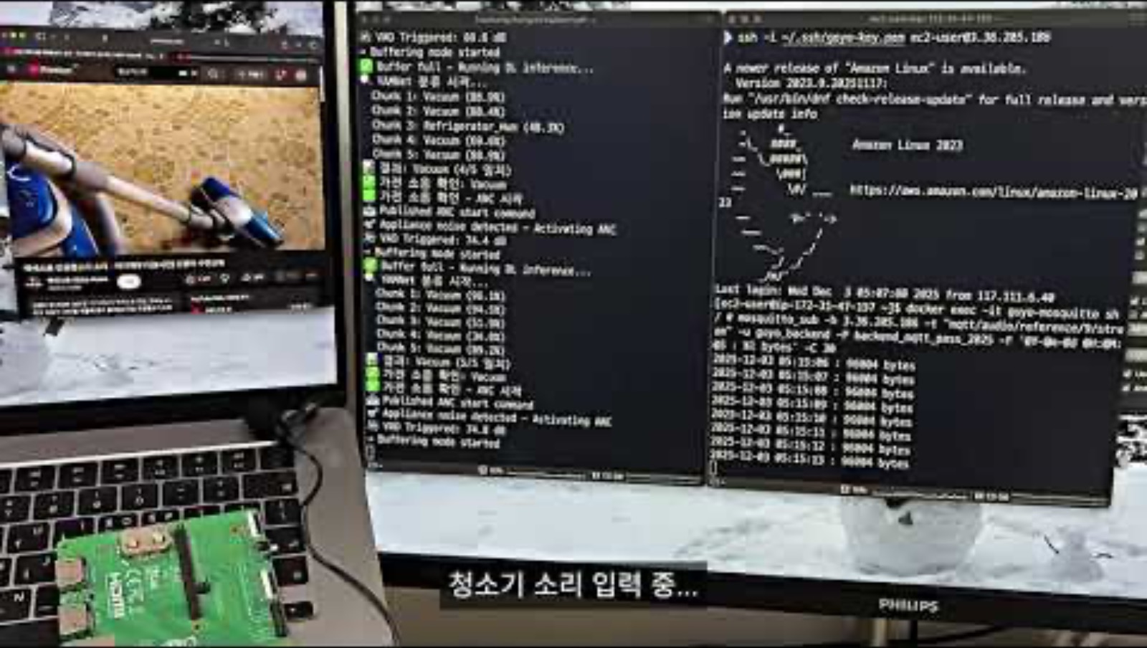
Demo Video

Slide 6



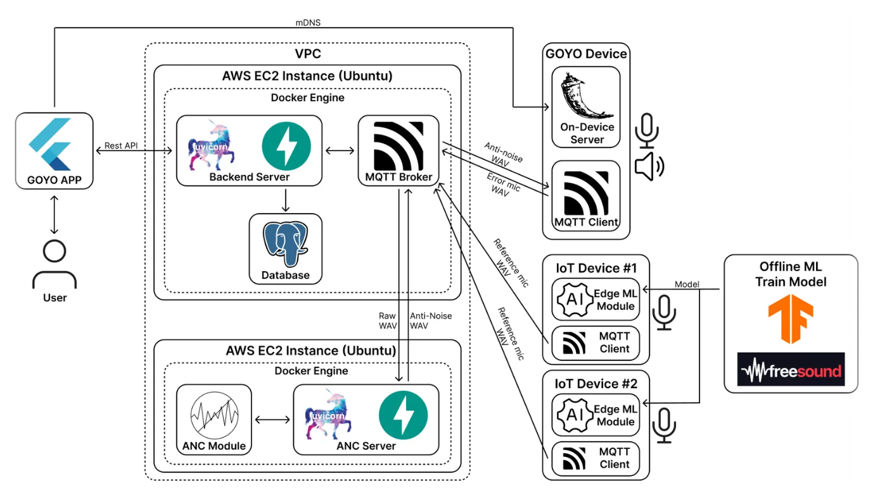
System Architecture

Slide 7










Technical features
Detection & Collection
Real-time Decibel Detection (VAD State Machine)
Collects buffered data with overlapping intervals
using Sliding Window method
Batch-based Verification
Generates control signals only upon >80% match
within a 3-second buffer
Minimizes the risk of misclassification

Slide 8








Dataset & training
Dataset
Preprocessing & Argumentation
Used open source data
UrbanSound8K, ESC-50, Freesound API Target (40~60 for each class)
Refridgeator, Vacuum Cleaner, AC
Microwave, Hair Dryer
Non-Target (190)
Daily Life Noise (e.g. Conversation)
Total 480+ audio data set
Data Preprocessing
Resampled all audio to 16kHz and removed silent intervals
Data Augmentation
Noise Injection & Pitch Shifting
To address low diversity by insufficient Target data
Relatively higher augmentation probability to Target class

Slide 9
Dataset & training
Model Training
Base Model: YAMNet
Audio classification model based on MobileNet, optimized for mobile and edge environments
2-Phase Fine-tuning
Phase 1 : Backbone Freeze
Phase 2 : Backbone Unfreeze & Low Learning Rate
Parameter
Epoch: 100 Batch size: 16

Slide 10






Backbone Model
YAMNet
PANNs
Accuracy
Outperformed PANNs +20.7%p
Low Latency
6x faster inference speed
Lightweight architecture
Optimized for storage-constrained edge devices
Model Size
(MB)
3.05
311.2
4.02
Parameters
(Million)
81.3
Inference speed
(ms)
34
215
84.2
Accuracy
(%)
63.5

Slide 11





Model Compression
Before
(server/pc)
After
(Raspberry Pi)
TensorFlow
TFLite
Format
.keras
.tflite
Size
480MB
1MB
Inference Speed
2.5sec
< 0.1sec

Slide 12
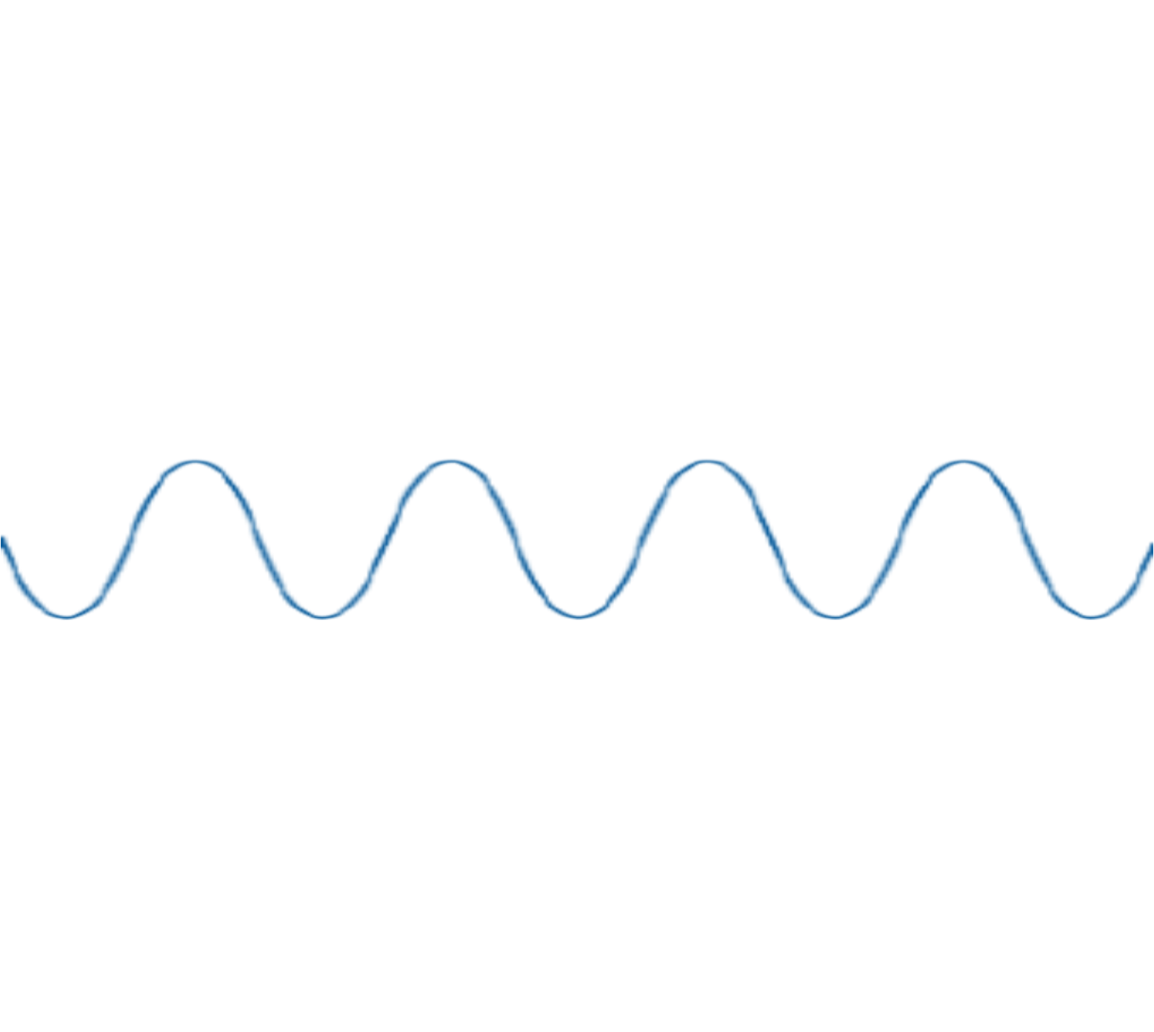
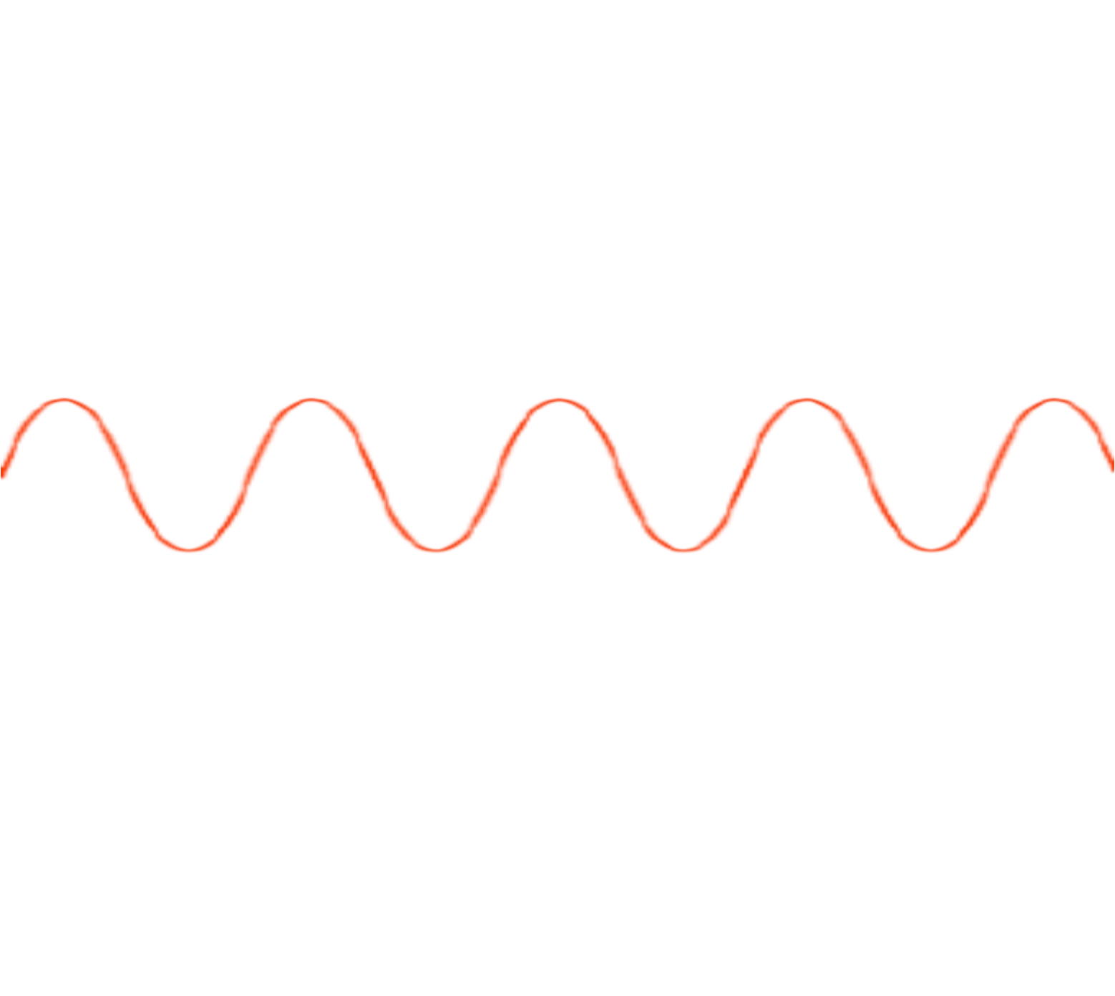




How ANC Works
Noise
Anti-noise

Slide 13









Spatial ANC
Filtered
Anti-noise
Anti-noise Speaker
ANC
Module
Reference
Noise
Feedback
Appliance
Error Mic
Reference Mic
User

Slide 14
2nd path
Target Noise
Anti-noise
Sound modified
By physical environment
User
Anti-noise Speaker

Slide 15
2nd path
Target Noise
Anti-noise
Sound modified
By physical environment
User
Anti-noise Speaker

Slide 16

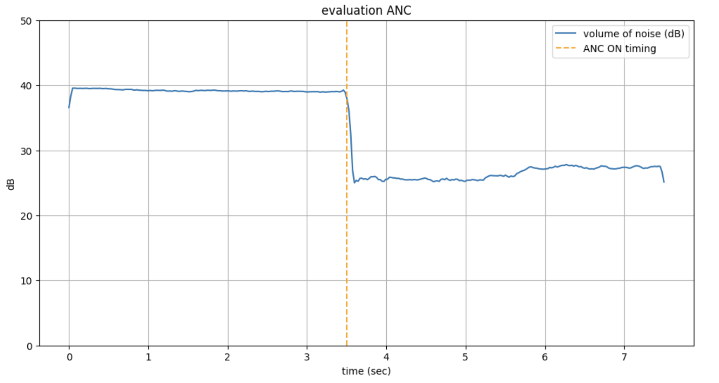
ANC Metrics

Slide 17


Conclusion
1
2
3
Achievement
Limitations
Future Improvement
Spatial ANC
Target noise classification
Real-time responsiveness
Hardware dependency
High latency sensitivity
Enhanced ANC algorithms
-RL adaptive ANC
-Time series analysis ANC

Slide 18





Thank You
Visit Link
github | https://github.com/SWE-ITE/GOYO
youtube | ~~
notion | ~~~~~

